Slide 1

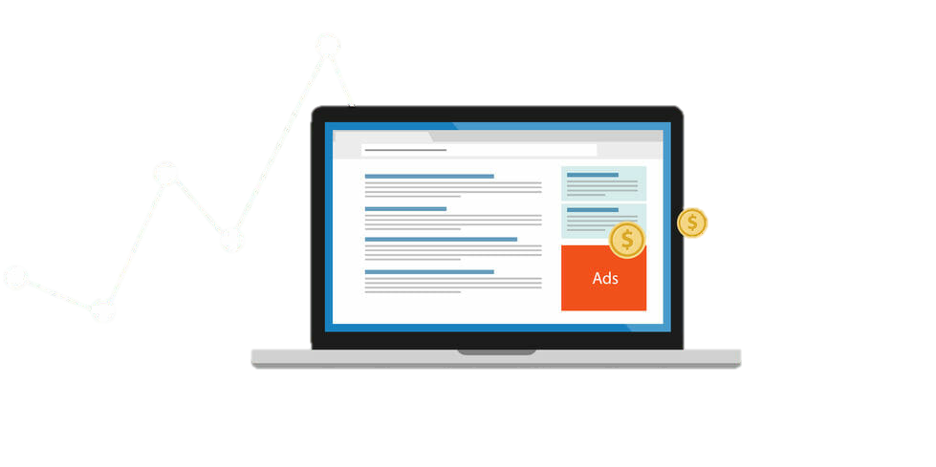
Ad Fraud – download prediction
Chris Lowe
Nazih Kalo
Markus Wehr

Slide 2
Outline
Business Problem
Dataset & Processing
Exploratory Data Analysis
Feature Engineering
Modeling
Conclusion & Future Work

Slide 3

1. Business Problem

Slide 4

Business Problem
FRAUD
~ $16.4 billion of losses in 2017 alone [2]
50% of ads are never seen by a human [2]
78% of marketers cite click fraud as their top concern [2]
Advertisers pay websites/app providers by click/per download
About $280 billion digital ad spending globally per year (2018) and growing [1]
Sources:
[1] https://www.emarketer.com/content/global-digital-ad-spending-2019
[2] https://medium.com/@aprofita_co/add-fraud-know-your-enemy-or-how-to-recognize-prevent-being-hacked-fc8caf19b1f2

Slide 5

Business Problem (cont.)
[1]
TalkingData is China’s largest independent big data platform
Covers ~ 70% of active mobile devices nationwide
Handle about 3 billion clicks per day, of which ~ 90% are potentially fraudulent
[2]
Fake Installs
Botnets: Bots designed to impersonate user behavior
App Install Farms: Low paid workers install apps through mobile ads
2. Fake Clicks
Click Bots
Click Farms
Ghost Websites
3. Fake Impressions
Hidden Adds
Invisible Pixels
Auto-Impression
Sources:
[1] https://www.kaggle.com/c/talkingdata-adtracking-fraud-detection
[2] https://medium.com/@aprofita_co/add-fraud-know-your-enemy-or-how-to-recognize-prevent-being-hacked-fc8caf19b1f2

Slide 6
2. Dataset & Processing

Slide 7
Dataset & Processing
# | Feature | Description | Type | # categories | # complete rows
1 | is_attributed | The target that is to be predicted, indicating if the app was downloaded | binary | 2 | 184,903,890
2 | ip | Ip address of click | categorical | 277,396 | 184,903,890
3 | app | App id for marketing | categorical | 706 | 184,903,890
4 | device | Type id of user mobile phone (e.g., iphone 7, huawei mate 7, etc.) | categorical | 3475 | 184,903,890
5 | os | Operating system version id of user mobile phone | categorical | 800 | 184,903,890
6 | channel | Channel id of mobile ad publisher | categorical | 202 | 184,903,890
7 | click_time | timestamp of click (UTC) | datetime | - | 184,903,890
Data collected over 4 days
CSV (Train ~ 7.3GB | Test ~ 2.6GB)
Changed datatypes to lower memory types (unint8, unint16, unint32)
Too large for local processing!

Slide 8
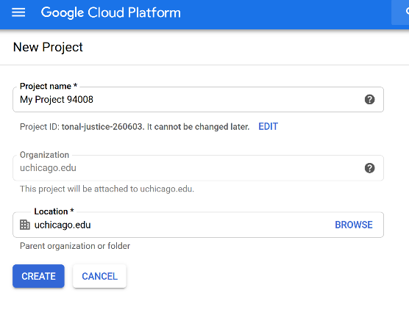
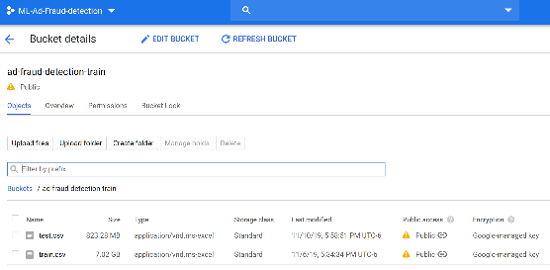
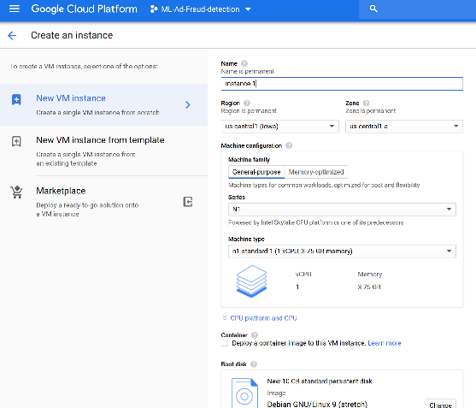
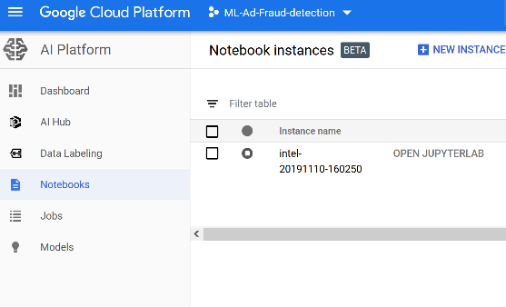
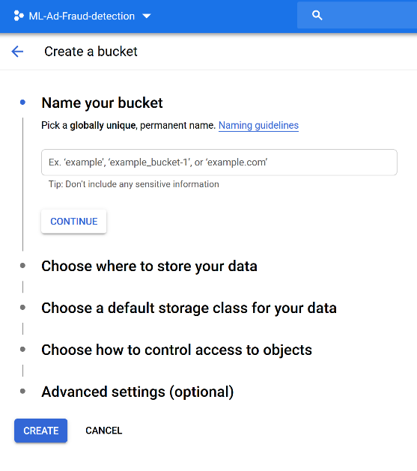
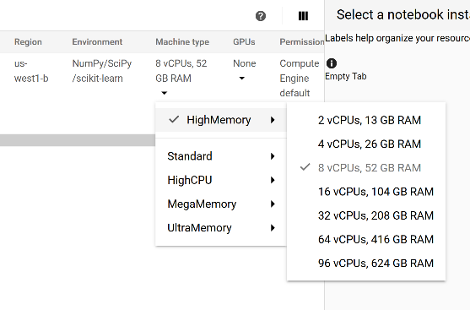
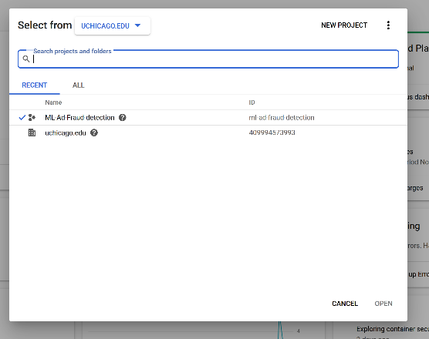
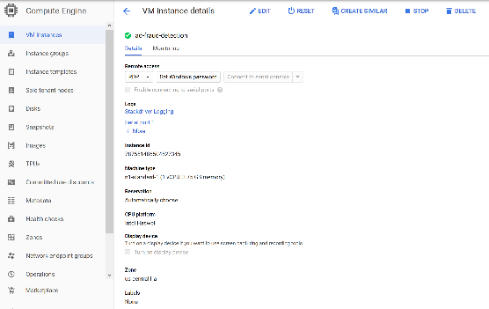
Dataset & Processing (cont.)
Using Google Cloud
1. Creating a new project in the cloud
2. Creating bucket and loading data
3. Creating virtual machine
4. Creating notebook + selecting machine type

Slide 9
3. Exploratory Data Analysis

Slide 10
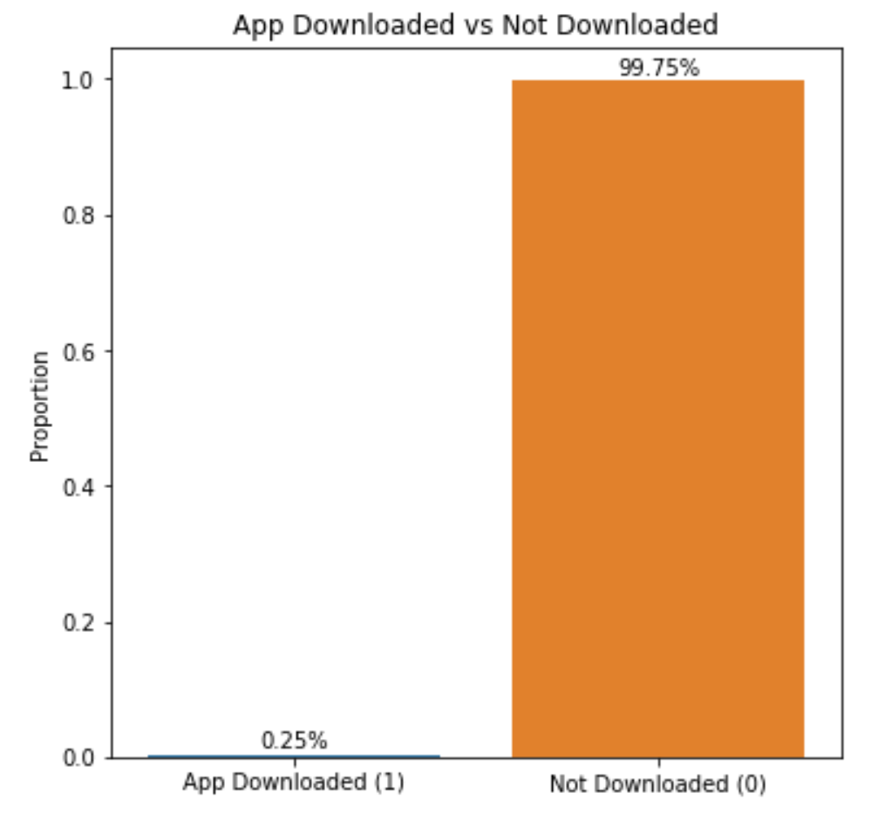
Exploratory Data Analysis
is_attributed:
Target variable is highly imbalanced
Only ~ 0.25% of clicks result in an actual download
Need to balance dataset!
Under-sampling
+ Reduce size of dataset
+ Computationally less expensive
- Lose a lot of data
Over-sampling (SMOTE)
+ Do not loose data
- Increases size of dataset
- Synthetic datapoints
- Computationally very expensive
Notes:
Realized that the dataset is highly imbalanced
Two options:
under-sampling, which would reduce the size and be more feasible computationally, but loose some data
Over-sampling, for example creating new instances using SMOTE
- Decided to under-sample, because we could barely handle the size of the original dataset

Slide 11
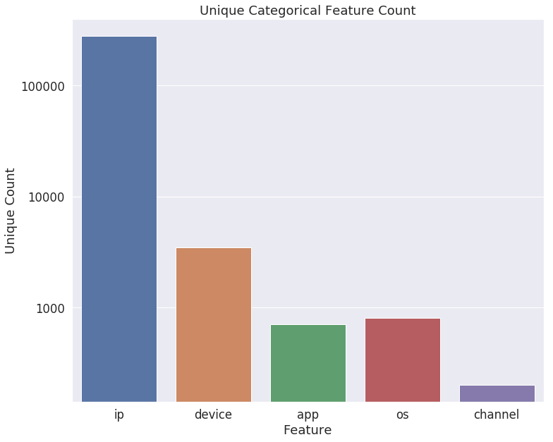
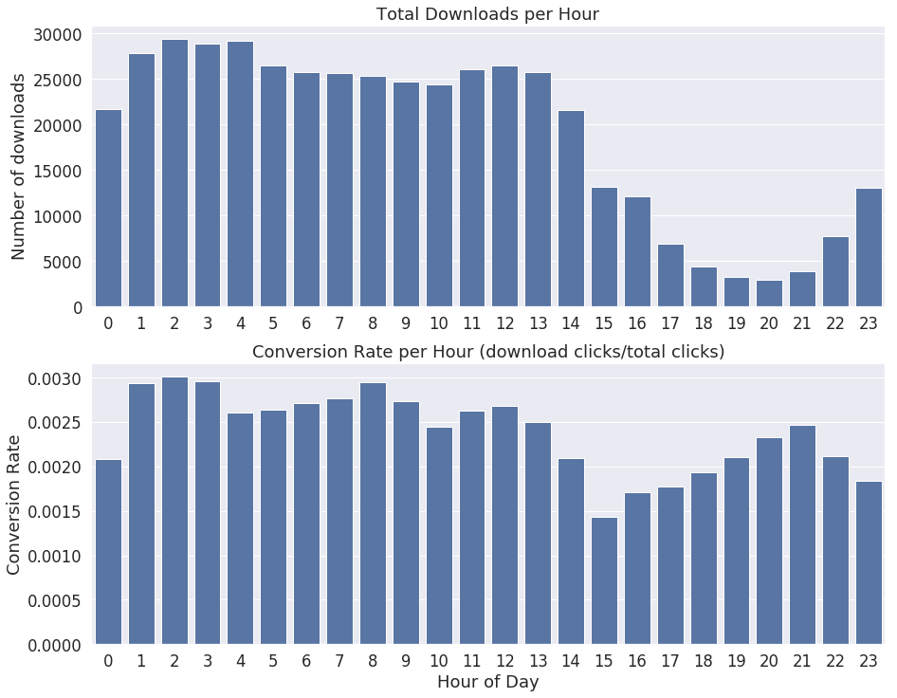
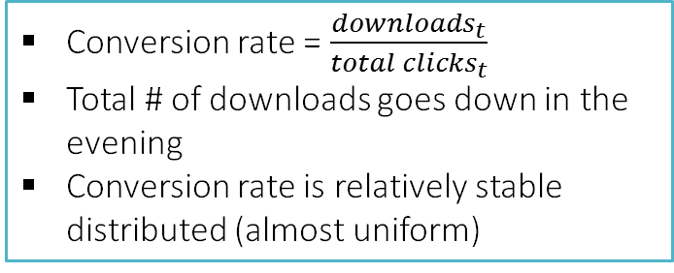
Exploratory Data Analysis (cont.)
By far most categories for ip (~ 2x device and ~ 4-5x app/os)
Least categories for channel
Grouping of most categories not possible (only IDs)
Conversion rate = $\frac{downloads_{t}}{total clicks_{t}}$
Total # of downloads goes down in the evening
Conversion rate is relatively stable distributed (almost uniform)
Notes:
We see that there are a lot of categories for ip and device
Total downloads vary by hour (go down in the evening), but conversion rate stays almost the same the whole day
So, most likely fraud is committet at a similar ratio all day

Slide 12
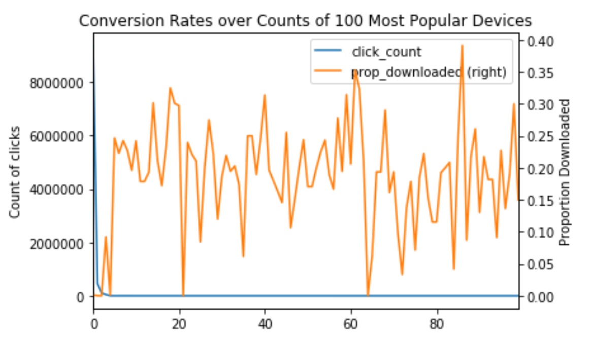
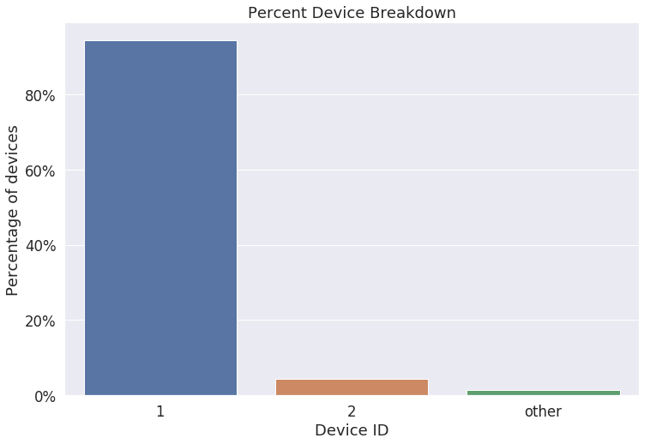
Exploratory Data Analysis (cont.)
device:
Conversion rate for 100 most popular devices (by click count) is similarly distributed, except for device 1
Device 1 has the most click and the lowest conversion rate, therefore, most fraudulent clicks are within that group
Group devices other than 1 or 2 into group ‘other’!
Notes:
We plottet the 100 devices with the most clicks in absolute terms and on a second axis looked at the conversion rate
Here we see that most of the clicks come from one device, so this is also the device where most fraud comes from
We only kept devices one and two and grouped all other devices into one group

Slide 13
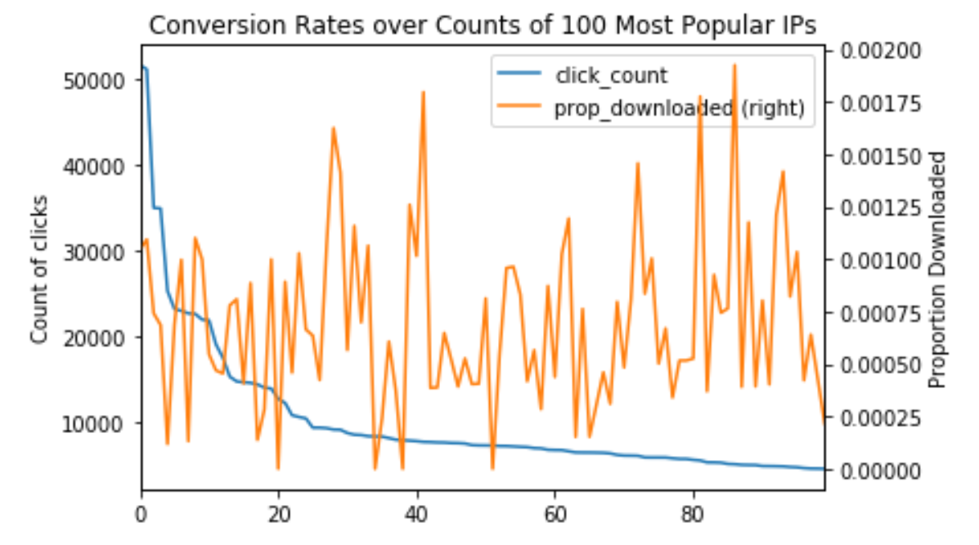
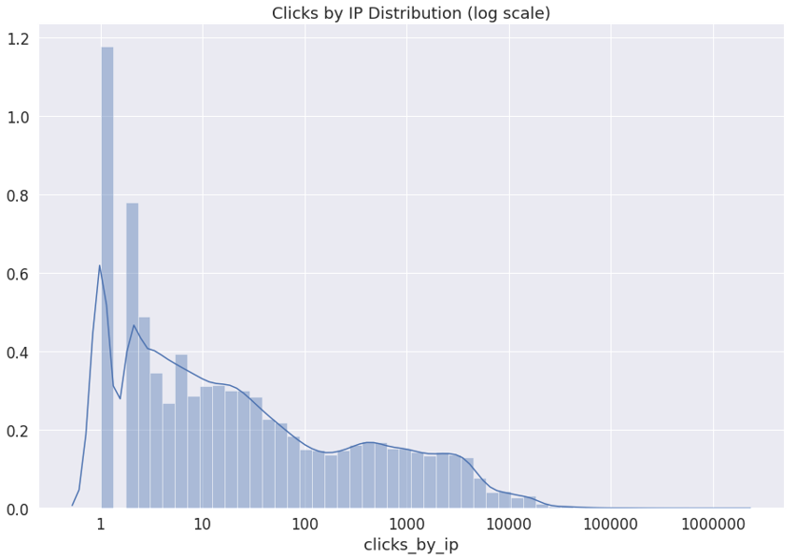
Exploratory Data Analysis (cont.)
ip:
Conversion rate is not dependent on total number of clicks per ip, according to the 100 most popular ips (by click)
About 10,000 different ips with a very high number of clicks, while the rest is relatively insignificant
Notes:
Same graph for ip addresses
It seems like even ips with a lot of clicks do not necessarily commit more fraud

Slide 14
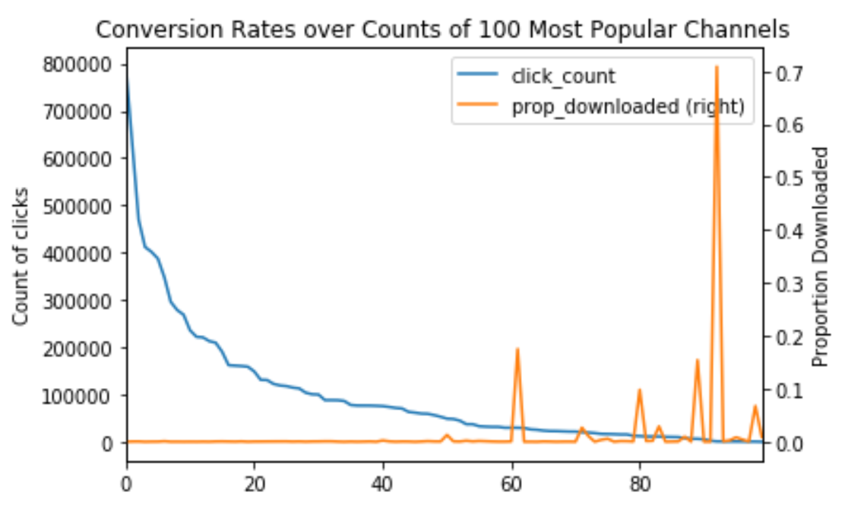
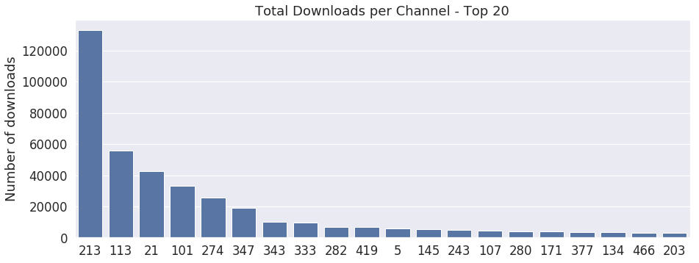
Exploratory Data Analysis (cont.)
channel:
Conversion rate is significantly lower for channels with a high absolute number of clicks
For top 20 channels (by number of clicks), conversion rates differ a lot
Channels with lower conversion rates and a high absolute number of clicks might be a sign for potential fraud
Notes:
For channels, we see a very different picture
Channels with a lot of clicks have a significantly lower conversion rate, which means a lot of clicks indicate fraudulent channels

Slide 15
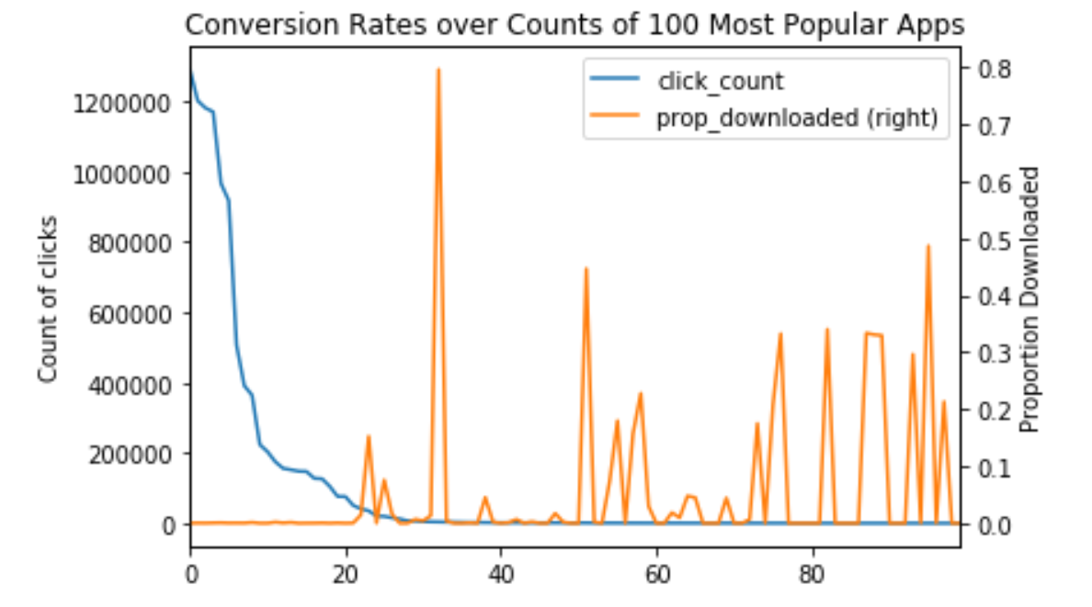
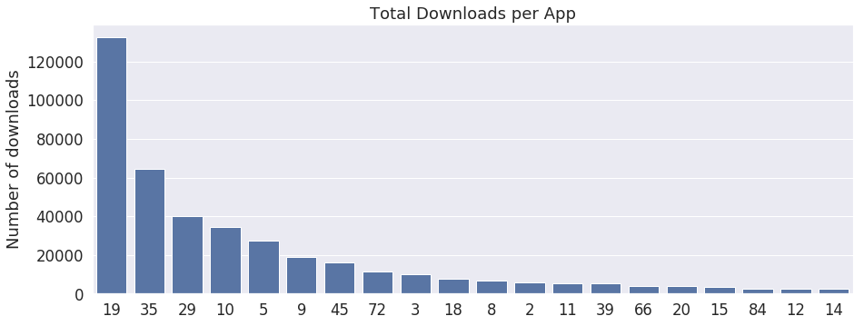
Exploratory Data Analysis (cont.)
app:
Conversion rate is significantly lower for top 20 apps (by click count)
For top 20 apps (by number of clicks), conversion rates differ a lot
Apps with lower conversion rates and a high absolute number of clicks might be a sign for potential fraud
Notes:
The same for apps, more clicks mean more fraud
Makes sense, since the app providers are mostly the ones committing the fraud

Slide 16
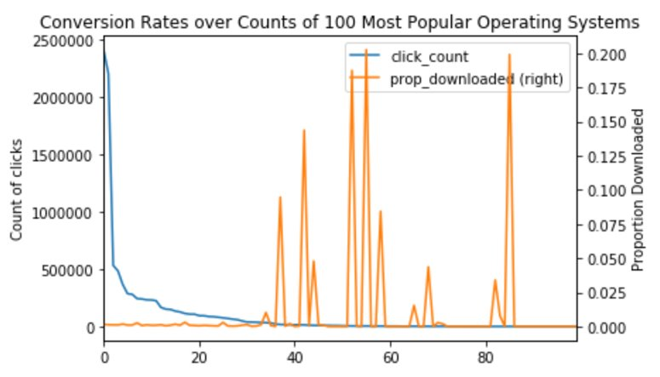
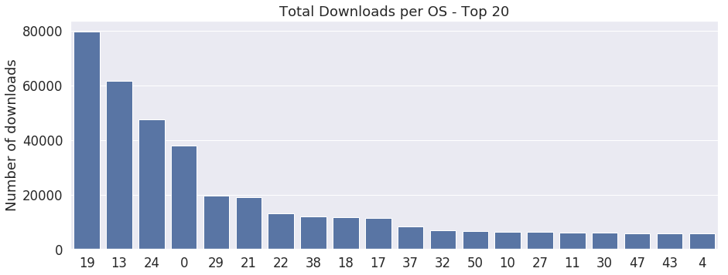
Exploratory Data Analysis (cont.)
os:
Conversion rate is significantly lower for top ~ 30 operating systems (by click count)
For top 20 os (by number of clicks), conversion rates differ a lot
Os with lower conversion rates and a high absolute number of clicks might be a sign for potential fraud
Notes:
Again, for operating systems we see the same trend, more clicks are most likely associated with more fraud
To summarize: From the EDA we suspect especially channels, apps, and operating systems to be fraudulent, if they have a high absolute number of clicks on ads

Slide 17
4. Feature Engineering

Slide 18
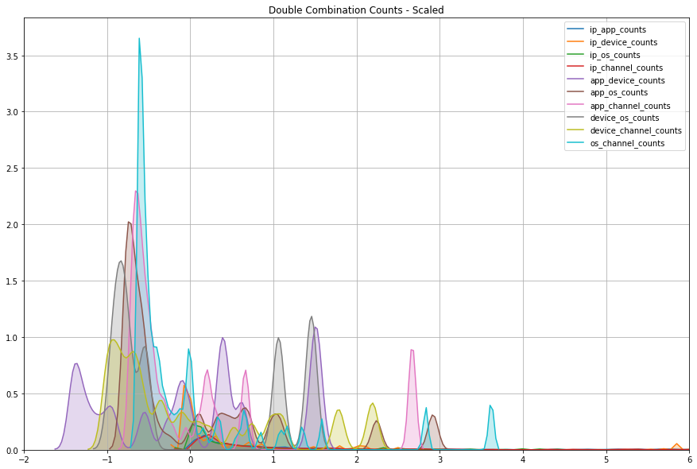
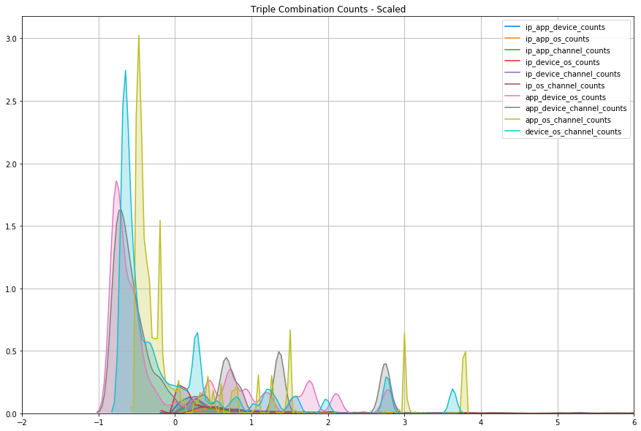
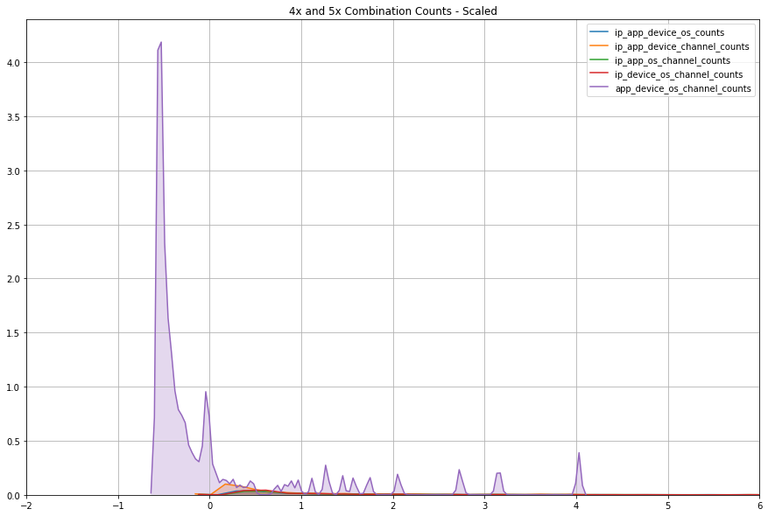
Feature Engineering
Combination counts
Each ‘click’ contains data about the ‘clicker’ – IP address, type of device, type of OS, etc.
To better understand the ‘clicker’ attribute interaction, we decided to use value counts along with combinatorics to identify any potentially recurring ‘clickers.’
These features were extracted by using a series of for loops to create the correct combinatorics sequence, followed by a pandas.Series.value_counts() function to count the number of times a combination occurred.
After scaling, this feature provides a ‘weight’ for how often the same combination occurs
Kernel density estimation plots of the various combinatorics

Slide 19
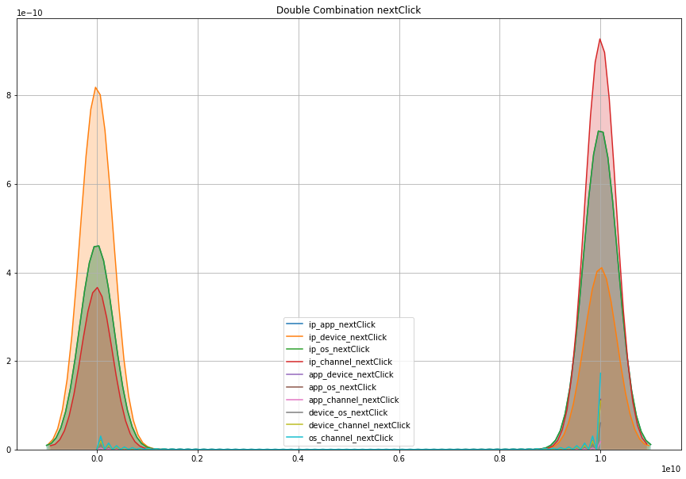
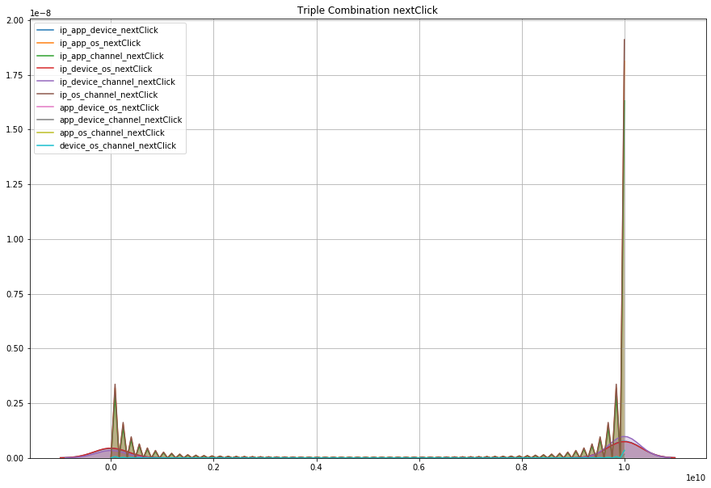
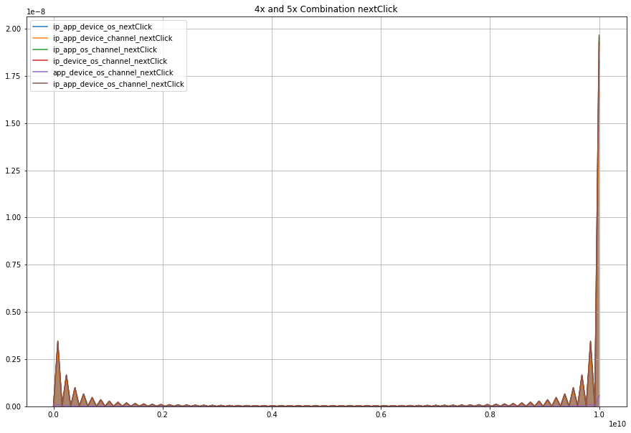
Feature Engineering (cont.)
Time to next click
Time to next click looks at the timing interval between different combinations of clickers.
For example, if a specific device and IP combination clicked on an ad, how long before that same device and IP combination clicked again?
Using combinatorics and a series of for loops, this process was carried out for double, triple, quadruple, and quintuple combinations.
The NaN values were replaced with a very high value – 1e10 to ‘filter’ out click patterns that did not recur
This feature searches for timed patterns – programs that potentially click an ad repeatedly every given step of time.
Kernel density estimation plots of the various combinatorics

Slide 20
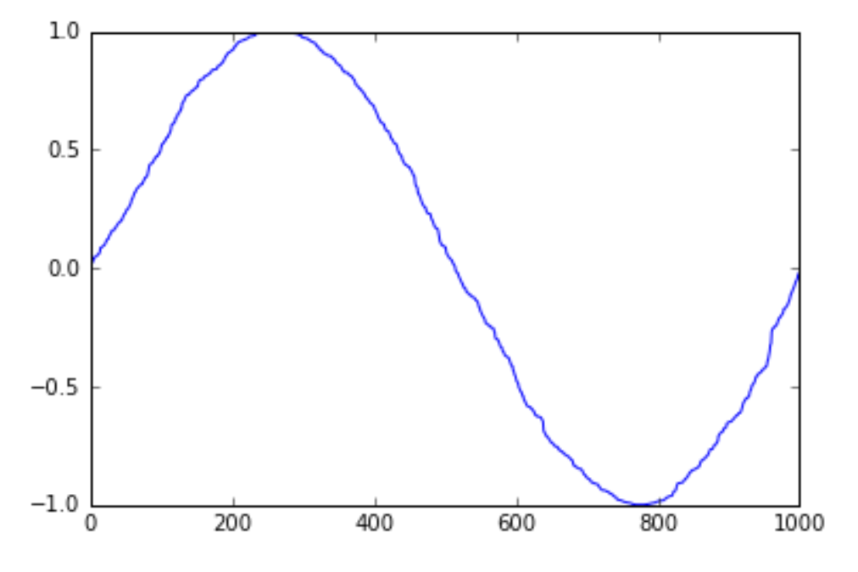
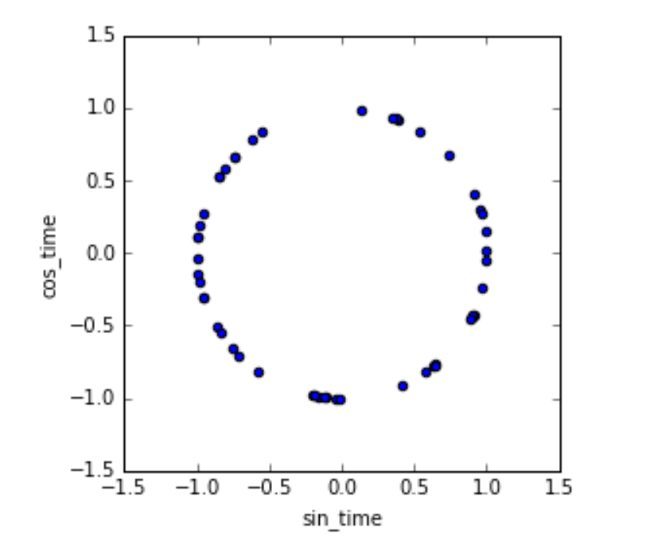
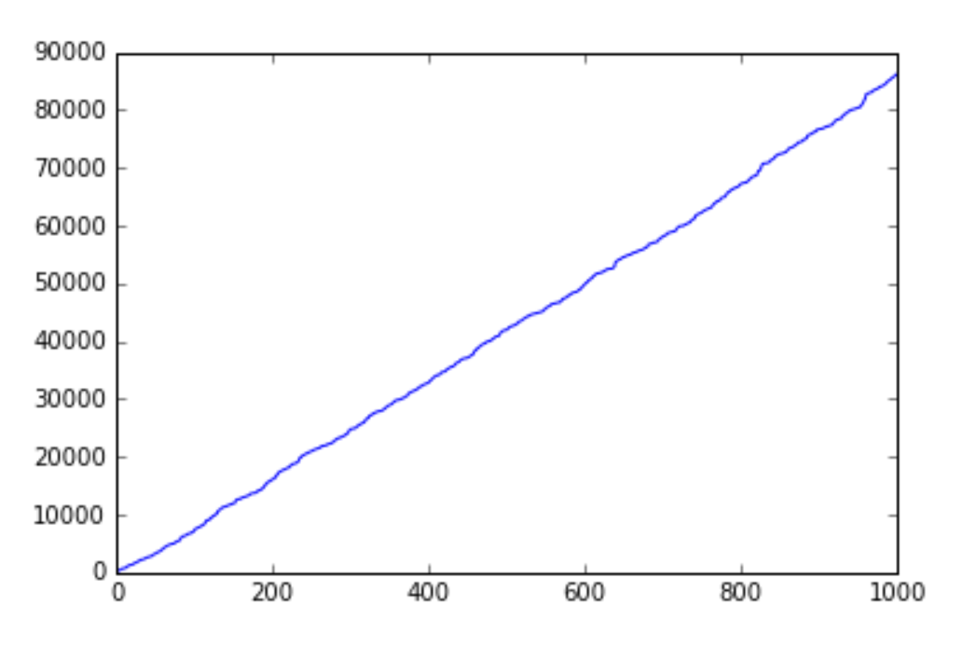
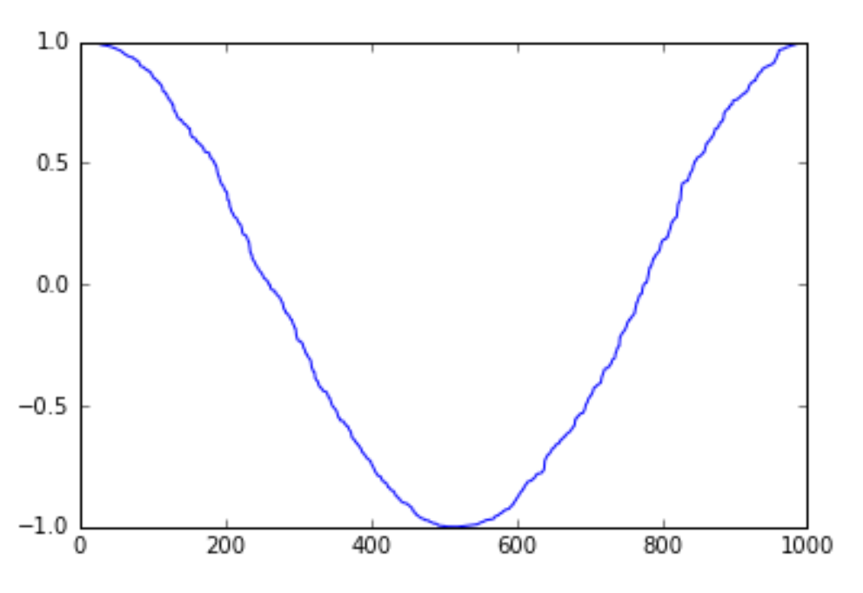
Feature Engineering (cont.)
Encoding cyclical continuous features –
Day and hour
sin
cos
Some features are cyclical (e.g., days, hours etc.)
Without transformation, cyclical nature is not conveyed
Encode as cyclical feature!
Deriving a sine transform and cosine transform for days and hours respectively (2 new columns each)
Both transformations needed to avoid side effects
Using the two features together, all times can be distinguished from each other
Difference corresponds to expected difference in time

Slide 21
5. Modeling

Slide 22
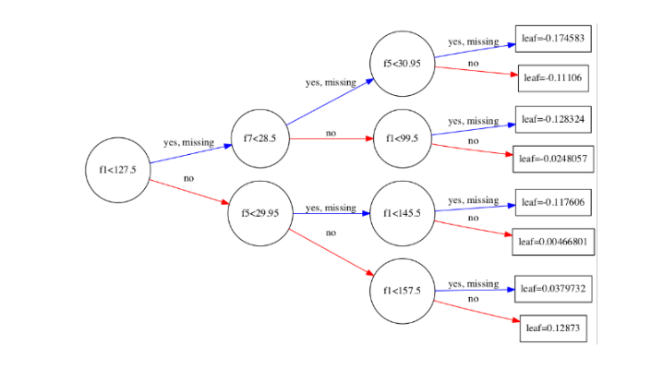
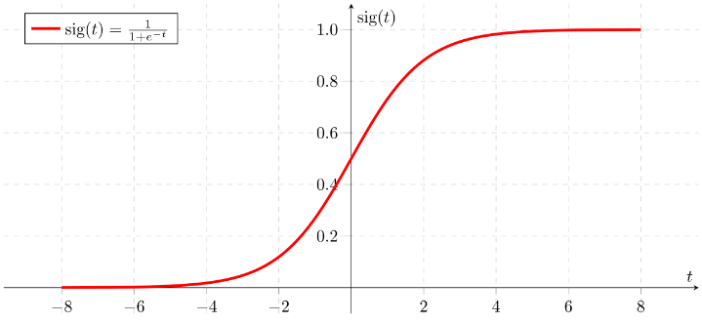
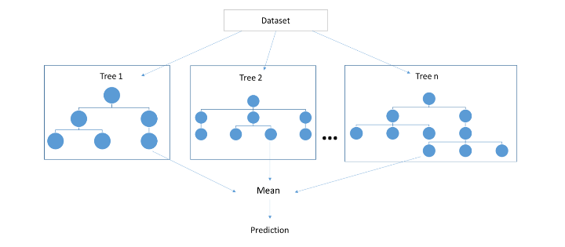
Modeling
Binary Logistic Regression
Random Forest
XGBoost
Advantages
Efficient & easy
Highly interpretable
Multicollinearity somewhat handled with L2 (Ridge)
Disadvantages
No large feature spaces
Does not handle many categorical features well
transformation for non-linear relations needed
Advantages
Performs well with noisy data
Reduces overfitting in DTs
Handles continuous and categorical features
Handles missing values
Robust to outliers
Disadvantages
More complex and computationally expensive
Greedy (prone to overfitting)
Advantages
Improves weak learners
Performs well on imbalanced data
Built in Regularization
Parallel processing makes it faster
Handles missing values
Removes splits that are not above threshold gain
Disadvantages
Easily overfits with noisy data
Hard to tune
Notes:
Decided to choose three different models:
One linear model, logistic regression, which is easy to compute, very interpretable, but cannot handle a lot of features, and especially categorical features, well, and needs a lot of transformation to model non-linear relationships
Parallel ensemble method Random Forest, that performs well with non-linear, noisy data and is robust to outliers, but is computationally more complex and easily overfits
Sequential ensemble method, ExtremeGradientBoosting, which performs well on imbalanced datasets, is faster to compute than Random Forest, but also easily overfits and is hard to tune

Slide 23
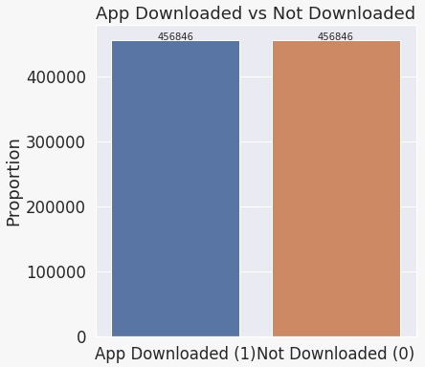
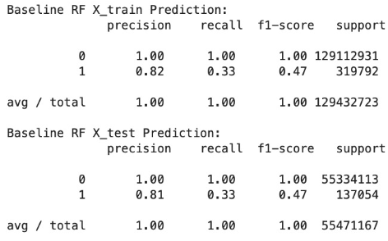
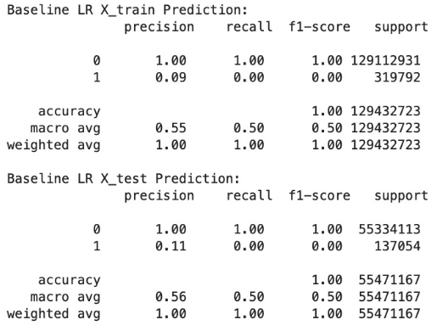
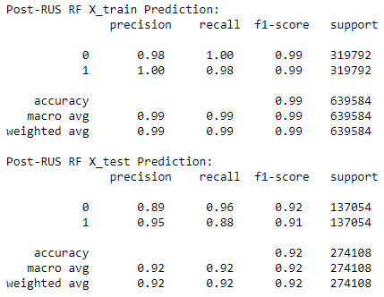
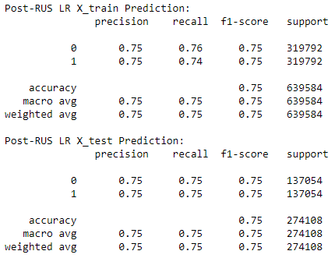
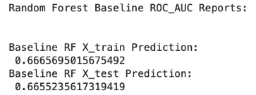
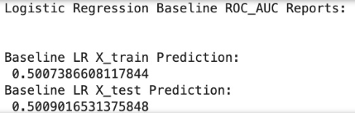
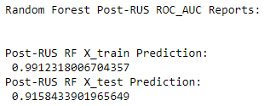
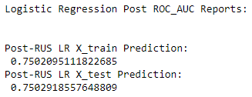

Modeling (cont.)
Baseline Model Performance
Model Performance after Random Undersampling
Overall baseline performance has difficulty with precision and recall of the ‘is_attributed’ prediction. This appears to be due to an anomaly detection task.
Random Forest performs noticeably better than Logistic Regression.
Random Undersampling drastically improves both the Random Forest and Logistic Regression models, while also improving the size of the dataset so it is more manageable.
Oversampling (SMOTE) was also tried and worked well on a subsample, however it is a bad choice for such a large dataset.
Notes:
Before doing anything else, we run Random Forest and Logistic Regression on the whole dataset, which didn’t give good results
No wonder, because by only predicting no download, it already predicts 99% of the data correctly
Running same models on the down-sampled dataset resulted in a nearly perfect fit for Random Forest, and about 75% F1-score for Logistic Regression

Slide 24
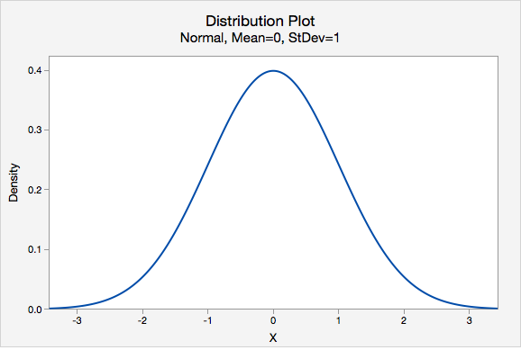
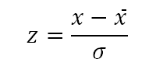
Modeling (cont.)
Stratified train and test sampling
Scaling
Test set
30%
0
$$z=\frac{x−\overline{x}}{σ}$$
Data
1
Train set
0
70%
1
Stratified sampling by is_attributed (target variable) with a 70/30 train-test split
50/50 distribution of downloads and non-downloads in train and test set
Standardized count features by removing the mean and scaling to unit variance
Zero mean and unit variance
Necessary especially for distance-based models
Notes:
Then moved on to divide our dataset into train and test by 70 to 30, stratified by the target column
Also used StandardScaler to normalize count features to zero mean and standard deviation of zero
This is not necessary for all models, but there is also no harm to it, and it can actually improve speed of computation for example

Slide 25
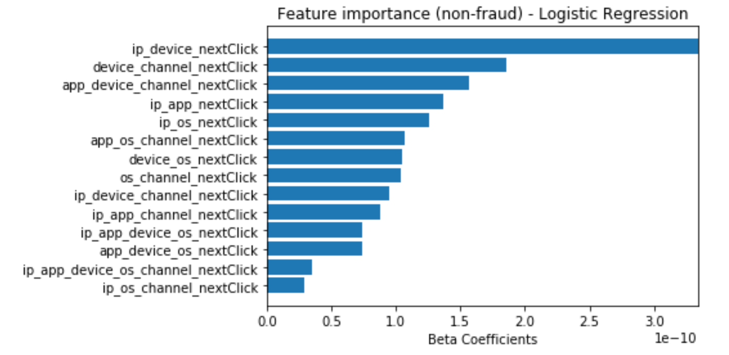
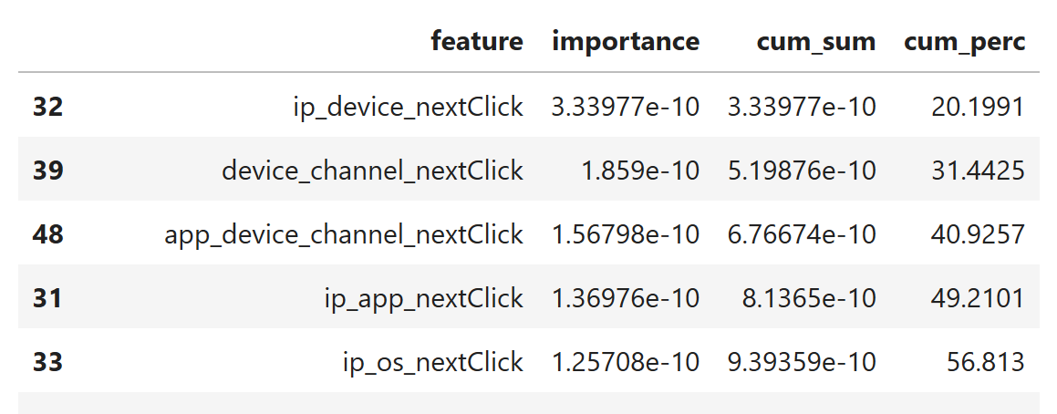
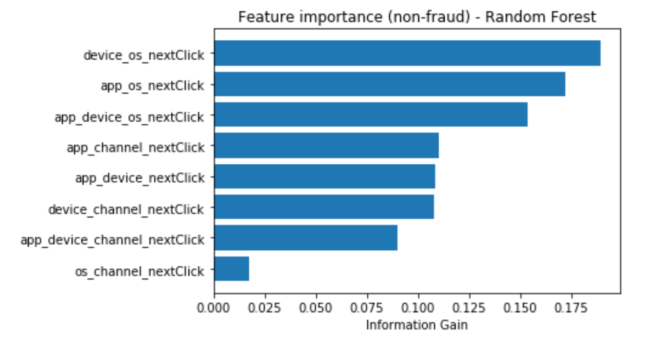

Modeling (cont.)
Dropped 14 features
Based on Beta coefficients and Information Gain, Next Click features appear to have the most impact on the model prediction
Ranked the features by IG and Beta Coefficients respectively and calculated cumulative percentage
Dropped all features that are not within the first 95% for both Random Forest and Logit
Additionally, the time of download was dropped previously to prevent leakage, although this might have had a high IG/Coefficient
Notes:
We then looked at the feature importance based on Random Forest and Logistic Regression, based on Information Gain and Beta coefficients respectively
Ranked features by importance
Calculated cumulative sum of importance
Calculated cumulative percentage
Deleted all features that were not within the first 95% for both Logit and Random Forest

Slide 26



Modeling (cont.)
Binary Logistic Regression
Random Forest
XGBoost
Results are very balanced between train, test, and cross-validation set
Precision higher than recall, so there is more emphasis on capturing all downloads in this model
The model is clearly overfit
Balancing the data previously actually introduced a bias to the model towards predicting more downloads than there actually are [1]
XGBoost seems to be overfit as well
Again, undersampling seems to have introduced a bias to the models
Source: [1] Dal Pozzolo et al. (2015): Calibrating Probability with Undersampling for Unbalanced Classification
Notes:
We now ran all three models on the reduced dataset
We see that the Logit model improved a little bit by about 3% based on F1-score
Random Forest and XGBoost return perfect fit, so most likely they are overfit
We suspect that this extreme overfit is mostly due to the fact that we under-sampled, but more on that in a minute

Slide 27




Modeling (cont.)
[1] Plus compared L1 (Lasso) vs L2 (Ridge) regularization.
Model | # of parameters | # of fits
Logistic Regression | 1 | 30
Random Forest | 4 | 243
XGBoost | 3 | 54
[1]
Binary Logistic Regression
Random Forest
XGBoost
Model predictions for logistic regression improved by ~1% based on F1-score
Regularization did not change results for Random Forest and XGBoost
Using XGBoost as model for final predictions because of its better generalizability on imbalanced dataset (expecting Holdout set to be highly imbalanced)
Notes:
We then tried to regularize the models by performing some parameter tuning
Logistic Regression actually imporved by about another percent to 79% F1-score
Random Forest and XGBoost didn’t change, still overfit
We decided to select XGBoost nonetheless, since it can handle imbalanced data very well, and we expect the holdout set to be similarly imbalanced as the training set

Slide 28




Modeling (cont.)
Since we are expecting the hold out set to be similarly imbalanced as the training set, our models will most likely deliver biased results
Among others, Dal Pozzolo et al. (2015) propose a solution by changing the threshold post downsampling and modeling (e.g., by using Bayesian approaches)
$p(y|x, real)≠p\left(y | x, undersampled\right)$, therefore, threshold needs to be adjusted to real probability distribution again
For this project, we are looking at the probabilities predicted (for class 1) and set the thresholds accordingly when applying the model on the Hold Out set (naïve approach)
XGBoost
Source: [1] Dal Pozzolo et al. (2015): Calibrating Probability with Undersampling for Unbalanced Classification
Notes:
Finally, something more on the problem of balancing your dataset
We found this very good paper in which they discuss the problems that can arise from balancing your data and how to solve it
Basically, the problem is that by balancing the dataset, the models learn a different distribution, in which a download for example is way more likely than in real life.
To adjust for this, when applying the final model to the real world, you need to change the probability threshold from 50% so that it counterbalances the effect
In our case, we would need to set the threshold a lot higher
There are sophisticated Bayesian models to derive the perfect threshold, but because of time constrains, we were not able to implement these
So, in our case we do kind of a naïve approach and just select a threshold based on the histogram of the probabilitis for downloads
For XGBoost, for example, we would select a threshold of somewhere beyond 90%

Slide 29
6. Conclusion

Slide 30
Conclusion & Future Work
Conclusion:
Anomaly detection problems require several methods to correctly classify binary or multiclass problems.
Feature Engineering was important to help improve the performance of the model based on AUC. In situations with very large datasets, appropriate feature selection is important to consider in data processing.
Sampling is a good solution for helping to deal with very unbalanced datasets to remove majority/minority bias. However, sampling also leads to apriori and aposterior probability differences due real data vs. manufactured data that affects test set model performance.
Future work:
For future work, we would like to investigate more sophisticated models of thresholding to counteract the overfitting that was produced during random undersampling. There are several cases applying Bayes’ theorem to reduce the Sample Selection Bias.

Slide 31
Thank you! - Questions?

